Slide 1
Epilogue: Knowing Jesus and His Word
2024 Quarter 4 Lesson 12
John 21

Slide 2
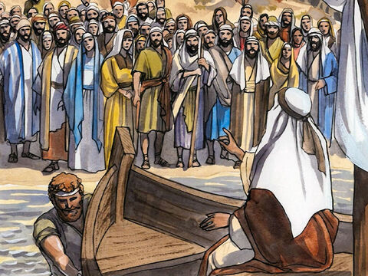
Called: Luke 5:3
And he entered into one of the ships, which was Simon's, and prayed him that he would thrust out a little from the land. And he sat down, and taught the people out of the ship.

Slide 3
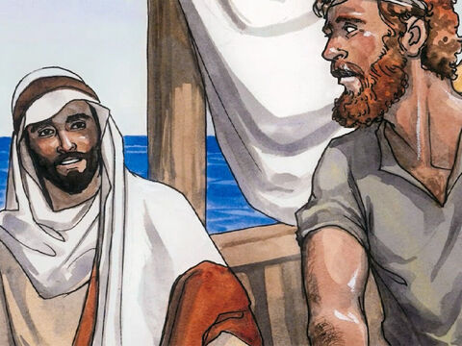
Called: Luke 5:4
Now when he had left speaking, he said unto Simon, Launch out into the deep, and let down your nets for a draught.

Slide 4
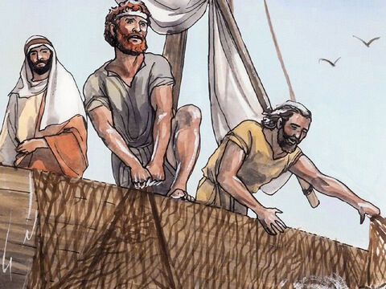
Called: Luke 5:5
And Simon answering said unto him, Master, we have toiled all the night, and have taken nothing: nevertheless at thy word I will let down the net.

Slide 5
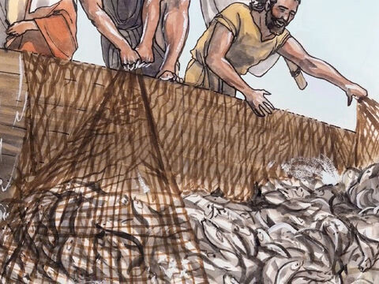
Called: Luke 5:6
And when they had this done, they inclosed a great multitude of fishes: and their net brake.

Slide 6
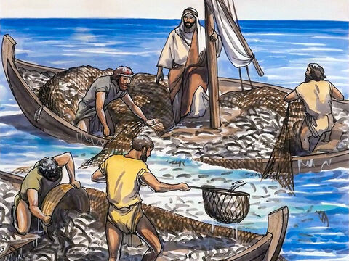
Called: Luke 5:7
And they beckoned unto their partners, which were in the other ship, that they should come and help them. And they came, and filled both the ships, so that they began to sink.

Slide 7
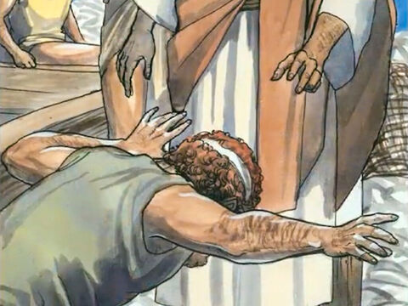
Called: Luke 5:8
When Simon Peter saw it, he fell down at Jesus' knees, saying, Depart from me; for I am a sinful man, O Lord.

Slide 8
Called: Luke 5:9
For he was astonished, and all that were with him, at the draught of the fishes which they had taken:

Slide 9
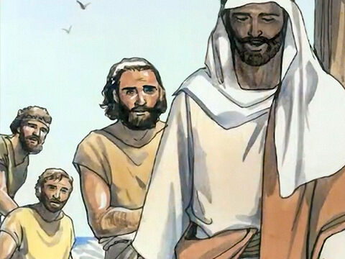
Called: Luke 5:10
And so was also James, and John, the sons of Zebedee, which were partners with Simon. And Jesus said unto Simon, Fear not; from henceforth thou shalt catch men.

Slide 10
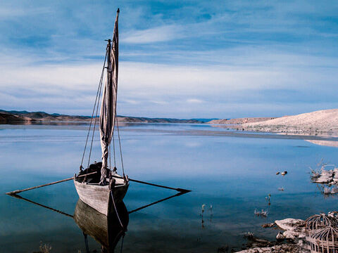
Called Again: John 21:1
After these things Jesus shewed himself again to the disciples at the sea of Tiberias; and on this wise shewed he himself.

Slide 11
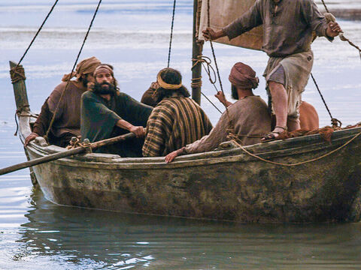
Called Again: John 21:2
There were together Simon Peter, and Thomas called Didymus, and Nathanael of Cana in Galilee, and the sons of Zebedee, and two other of his disciples.

Slide 12
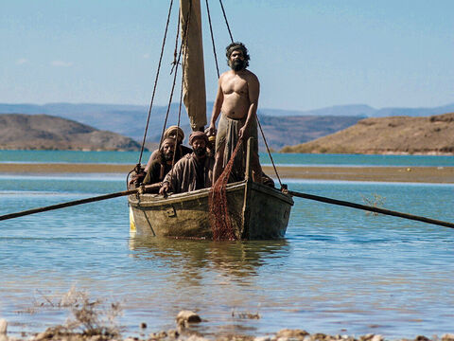
Called Again: John 21:3
Simon Peter saith unto them, I go a fishing. They say unto him, We also go with thee. They went forth, and entered into a ship immediately; and that night they caught nothing.

Slide 13
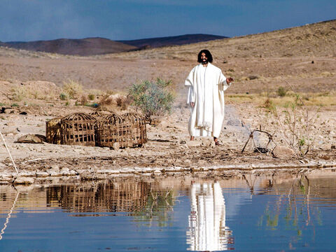
Called Again: John 21:4
But when the morning was now come, Jesus stood on the shore: but the disciples knew not that it was Jesus.

Slide 14
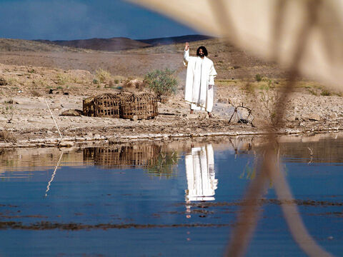
Called Again: John 21:5
Then Jesus saith unto them, Children, have ye any meat? They answered him, No.

Slide 15
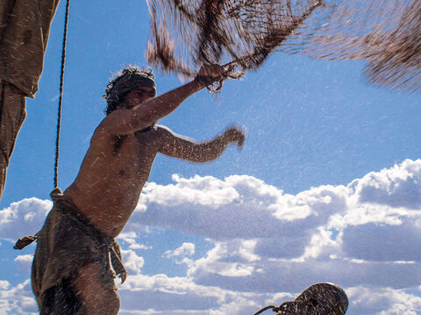
Called Again: John 21:6
And he said unto them, Cast the net on the right side of the ship, and ye shall find. They cast therefore, and now they were not able to draw it for the multitude of fishes.

Slide 16
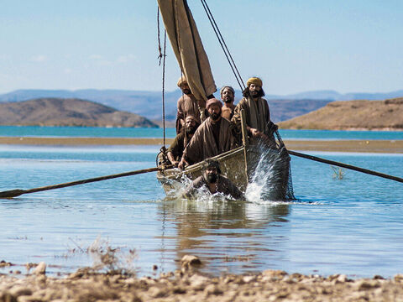
Sustained: John 21:7
Therefore that disciple whom Jesus loved saith unto Peter, It is the Lord. Now when Simon Peter heard that it was the Lord, he girt his fisher's coat unto him, (for he was naked,) and did cast himself into the sea.

Slide 17
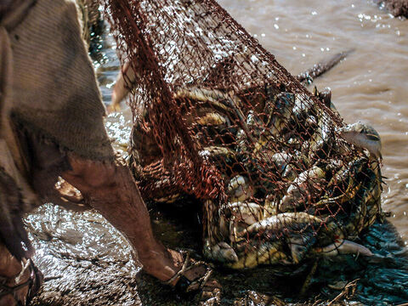
Sustained: John 21:8
And the other disciples came in a little ship; (for they were not far from land, but as it were two hundred cubits,) dragging the net with fishes.

Slide 18
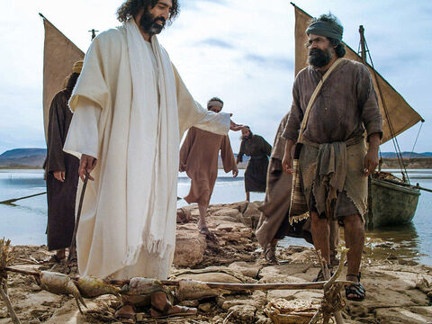
Sustained: John 21:9
As soon then as they were come to land, they saw a fire of coals there, and fish laid thereon, and bread.

Slide 19
Sustained: John 21:10
Jesus saith unto them, Bring of the fish which ye have now caught.

Slide 20
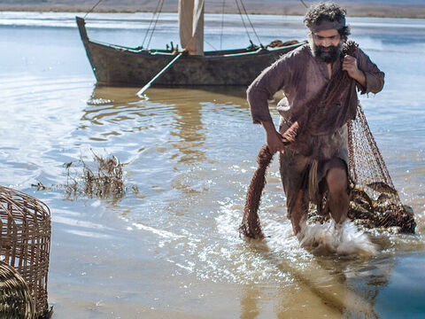
Sustained: John 21:11
Simon Peter went up, and drew the net to land full of great fishes, an hundred and fifty and three: and for all there were so many, yet was not the net broken.

Slide 21
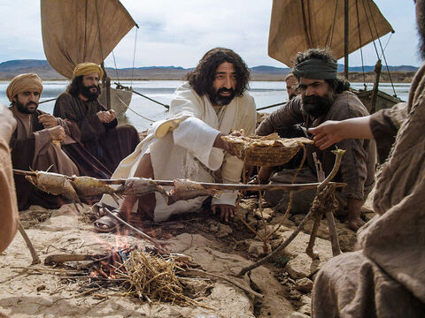
Sustained: John 21:12
Jesus saith unto them, Come and dine. And none of the disciples durst ask him, Who art thou? knowing that it was the Lord.

Slide 22
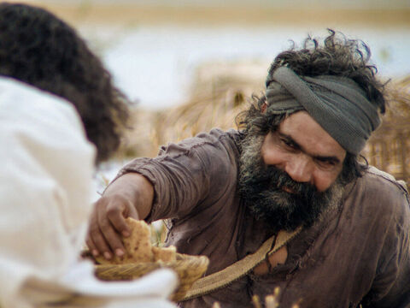
Sustained: John 21:13
Jesus then cometh, and taketh bread, and giveth them, and fish likewise.

Slide 23
Sustained: John 21:14
This is now the third time that Jesus shewed himself to his disciples, after that he was risen from the dead.

Slide 24
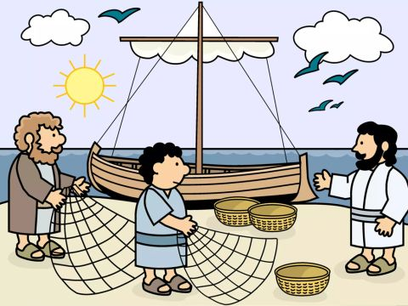
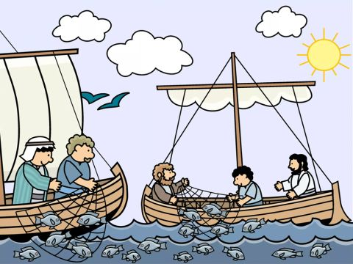
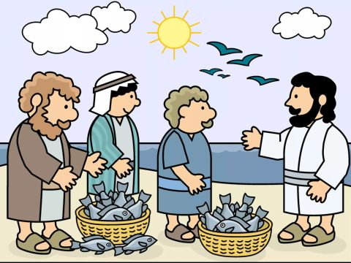
Twice Called: The Desire of Ages p. 810
Vividly they recalled the scene beside the sea when Jesus had bidden them follow Him. They remembered how, at His command, they had launched out into the deep, and had let down their net, and the catch had been so abundant as to fill the net, even to breaking. Then Jesus had called them to leave their fishing boats, and had promised to make them fishers of men.

Slide 25
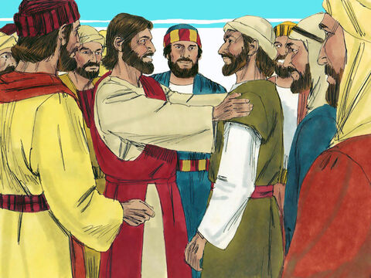
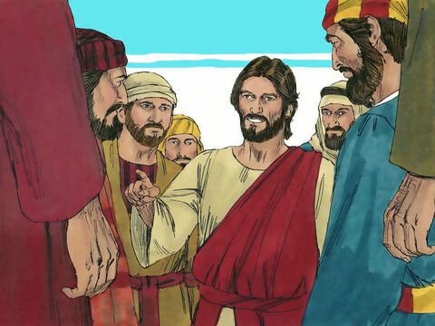
Twice Called: The Desire of Ages p. 810
It was to bring this scene to their minds, and to deepen its impression, that He had again performed the miracle. His act was a renewal of the commission to the disciples. It showed them that the death of their Master had not lessened their obligation to do the work He had assigned them.

Slide 26
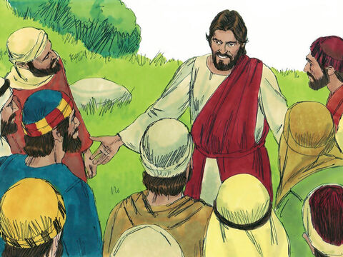
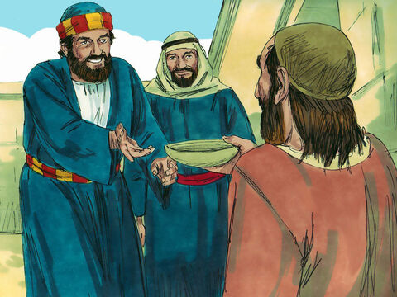
Twice Called: The Desire of Ages p. 810
Though they were to be deprived of His personal companionship, and of the means of support by their former employment, the risen Saviour would still have a care for them. While they were doing His work, He would provide for their needs. And Jesus had a purpose in bidding them cast their net on the right side of the ship. On that side He stood upon the shore.

Slide 27
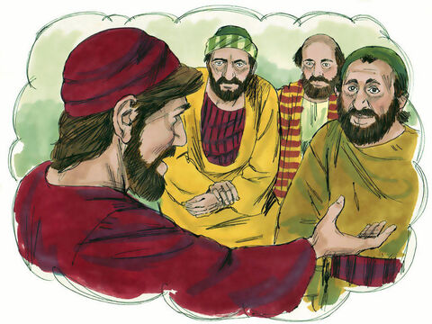
Twice Called: The Desire of Ages p. 810
That was the side of faith. If they labored in connection with Him,—His divine power combining with their human effort,—they could not fail of success.

Slide 28
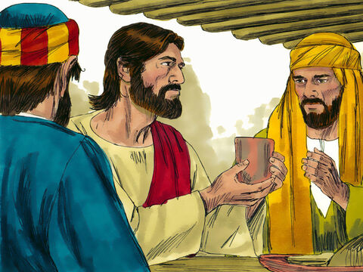
Offended: Matthew 26:31
Then saith Jesus unto them, All ye shall be offended because of me this night: for it is written, I will smite the shepherd, and the sheep of the flock shall be scattered abroad.

Slide 29
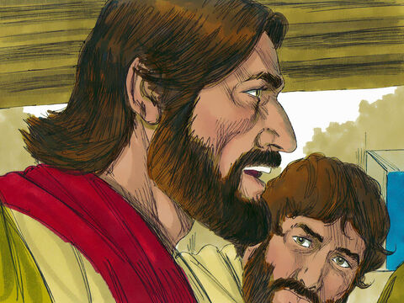
Offended: Matthew 26:32
But after I am risen again, I will go before you into Galilee.

Slide 30
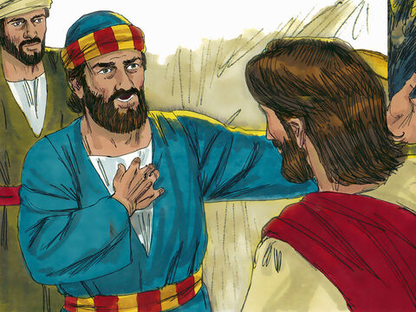
Offended: Matthew 26:33
Peter answered and said unto him, Though all men shall be offended because of thee, yet will I never be offended.

Slide 31
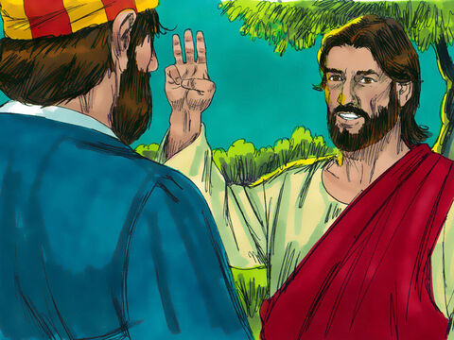
Offended: Matthew 26:34
Jesus said unto him, Verily I say unto thee, That this night, before the cock crow, thou shalt deny me thrice.

Slide 32
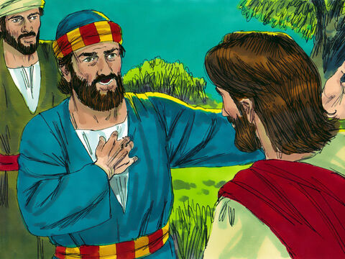
Offended: Matthew 26:35
Peter said unto him, Though I should die with thee, yet will I not deny thee. Likewise also said all the disciples.

Slide 33
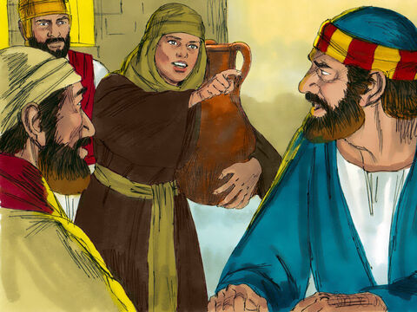
Offended: Matthew 26:69
Now Peter sat without in the palace: and a damsel came unto him, saying, Thou also wast with Jesus of Galilee.

Slide 34
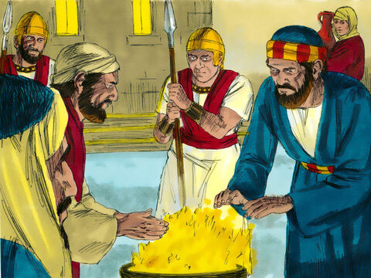
Offended: Matthew 26:70
But he denied before them all, saying, I know not what thou sayest.

Slide 35
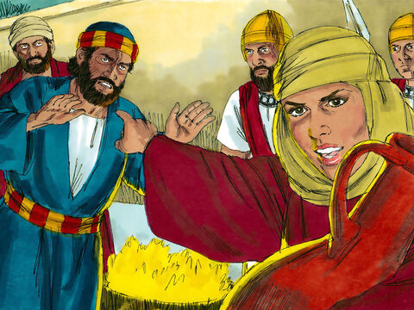
Offended: Matthew 26:71
And when he was gone out into the porch, another maid saw him, and said unto them that were there, This fellow was also with Jesus of Nazareth.

Slide 36
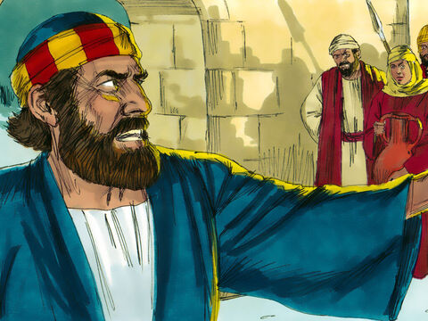
Offended: Matthew 26:72
And again he denied with an oath, I do not know the man.

Slide 37
Offended: Matthew 26:73
And after a while came unto him they that stood by, and said to Peter, Surely thou also art one of them; for thy speech bewrayeth thee.

Slide 38
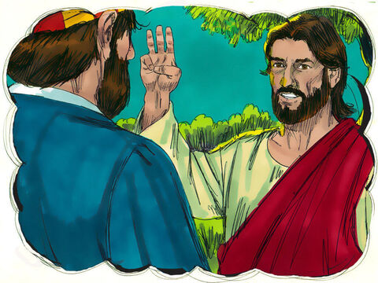
Offended: Matthew 26:74
Then began he to curse and to swear, saying, I know not the man. And immediately the cock crew.

Slide 39
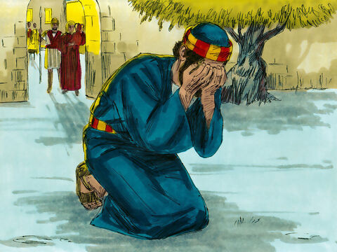
Offended: Matthew 26:75
And Peter remembered the word of Jesus, which said unto him, Before the cock crow, thou shalt deny me thrice. And he went out, and wept bitterly.

Slide 40
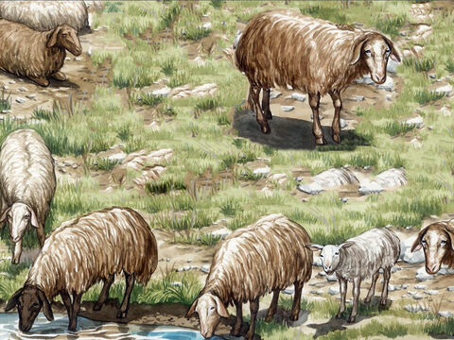
Sent: John 21:15
So when they had dined, Jesus saith to Simon Peter, Simon, son of Jonas, lovest thou me more than these? He saith unto him, Yea, Lord; thou knowest that I love thee. He saith unto him, Feed my lambs.

Slide 41
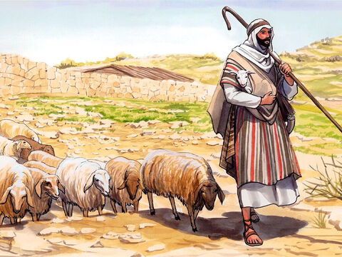
Sent: John 21:16
He saith to him again the second time, Simon, son of Jonas, lovest thou me? He saith unto him, Yea, Lord; thou knowest that I love thee. He saith unto him, Feed my sheep.

Slide 42
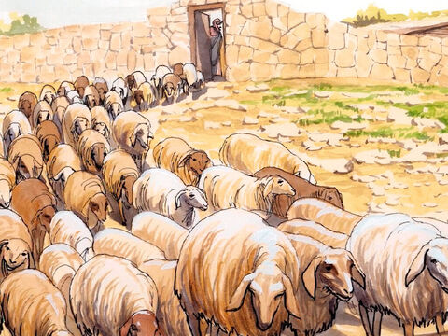
Sent: John 21:17
He saith unto him the third time, Simon, son of Jonas, lovest thou me? Peter was grieved because he said unto him the third time, Lovest thou me? And he said unto him, Lord, thou knowest all things; thou knowest that I love thee. Jesus saith unto him, Feed my sheep.

Slide 43
Humility: The Desire of Ages p. 811
While Christ and the disciples were eating together by the seaside, the Saviour said to Peter, “Simon, son of Jonas, lovest thou Me more than these?” referring to his brethren. Peter had once declared, “Though all men shall be offended because of Thee, yet will I never be offended.” Matthew 26:33. But he now put a truer estimate upon himself. “Yea, Lord,” he said, “Thou knowest that I love Thee.”.”

Slide 44
Humility: The Desire of Ages p. 811
There is no vehement assurance that his love is greater than that of his brethren. He does not express his own opinion of his devotion. To Him who can read all the motives of the heart he appeals to judge as to his sincerity,—“Thou knowest that I love Thee.” And Jesus bids him, “Feed My lambs.”

Slide 45
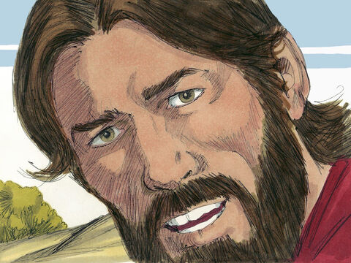
Following: John 21:18
Verily, verily, I say unto thee, When thou wast young, thou girdedst thyself, and walkedst whither thou wouldest: but when thou shalt be old, thou shalt stretch forth thy hands, and another shall gird thee, and carry thee whither thou wouldest not.

Slide 46
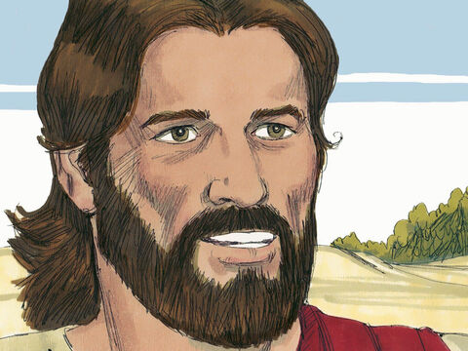
Following: John 21:19
This spake he, signifying by what death he should glorify God. And when he had spoken this, he saith unto him, Follow me.

Slide 47
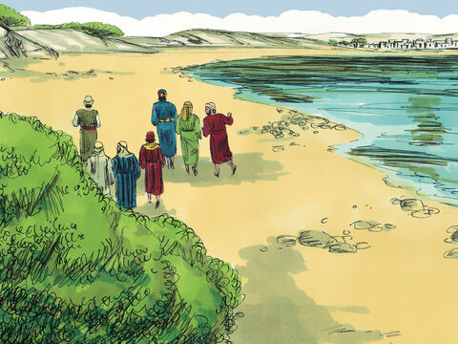
Following: John 21:20
Then Peter, turning about, seeth the disciple whom Jesus loved following; which also leaned on his breast at supper, and said, Lord, which is he that betrayeth thee?

Slide 48
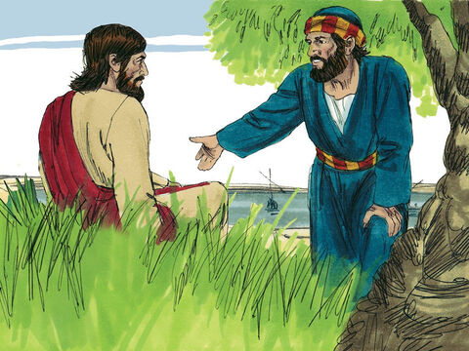
Following: John 21:21
Peter seeing him saith to Jesus, Lord, and what shall this man do?

Slide 49
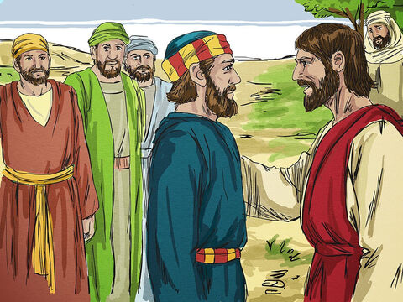
Following: John 21:22
Jesus saith unto him, If I will that he tarry till I come, what is that to thee? follow thou me.

Slide 50
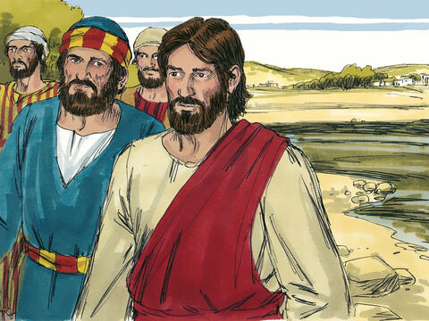
Following: John 21:23
Then went this saying abroad among the brethren, that that disciple should not die: yet Jesus said not unto him, He shall not die; but, If I will that he tarry till I come, what is that to thee?

Slide 51
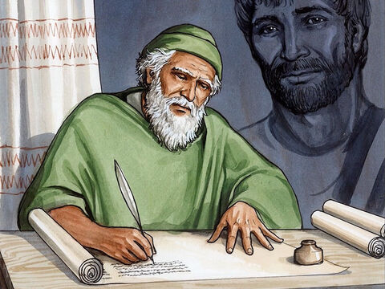
Following: John 21:24
This is the disciple which testifieth of these things, and wrote these things: and we know that his testimony is true.

Slide 52

Following: John 21:25
And there are also many other things which Jesus did, the which, if they should be written every one, I suppose that even the world itself could not contain the books that should be written. Amen.

Slide 53
Happy Sabbath!
Thanks for joining us!

